Slide 1
Welcome to Class 2

Slide 2
We have been working hard to form our fantastic team.

Slide 3
Cool Class 2!
Cool Class 2!

Slide 4
We have agreed our class rules (see our display)
We have drawn portraits to go on the display

Slide 5
We have agreed that:
We are kind
We try our best
We are friends
We don’t give up
We love to learn
We will get better

Slide 6
WE ARE A TEAM!

Slide 7
We have worked as a team to make some class art work.
We used the boxes from our new computers.

Slide 8
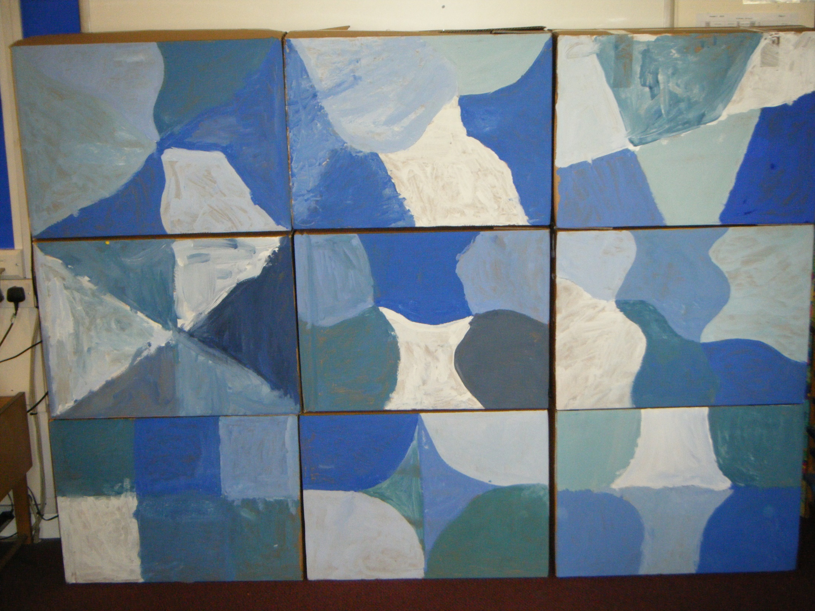
We used cold colours

Slide 9
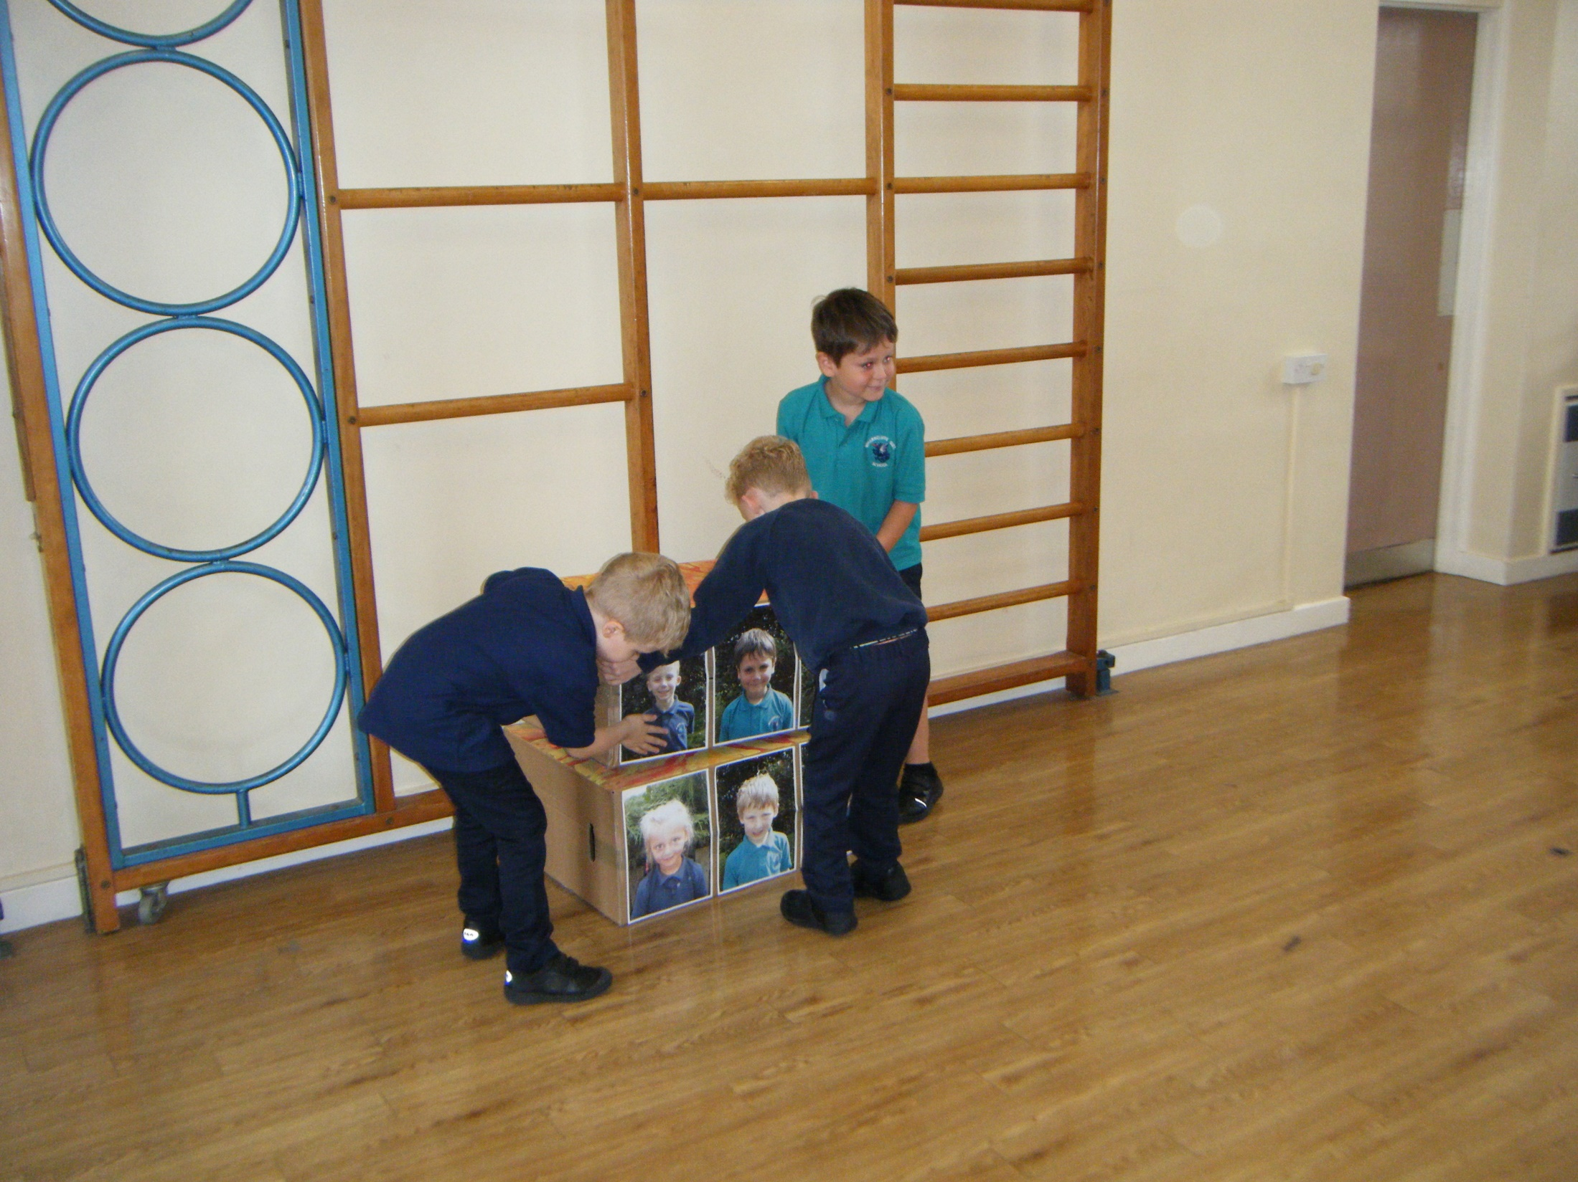
We used our photographs

Slide 10
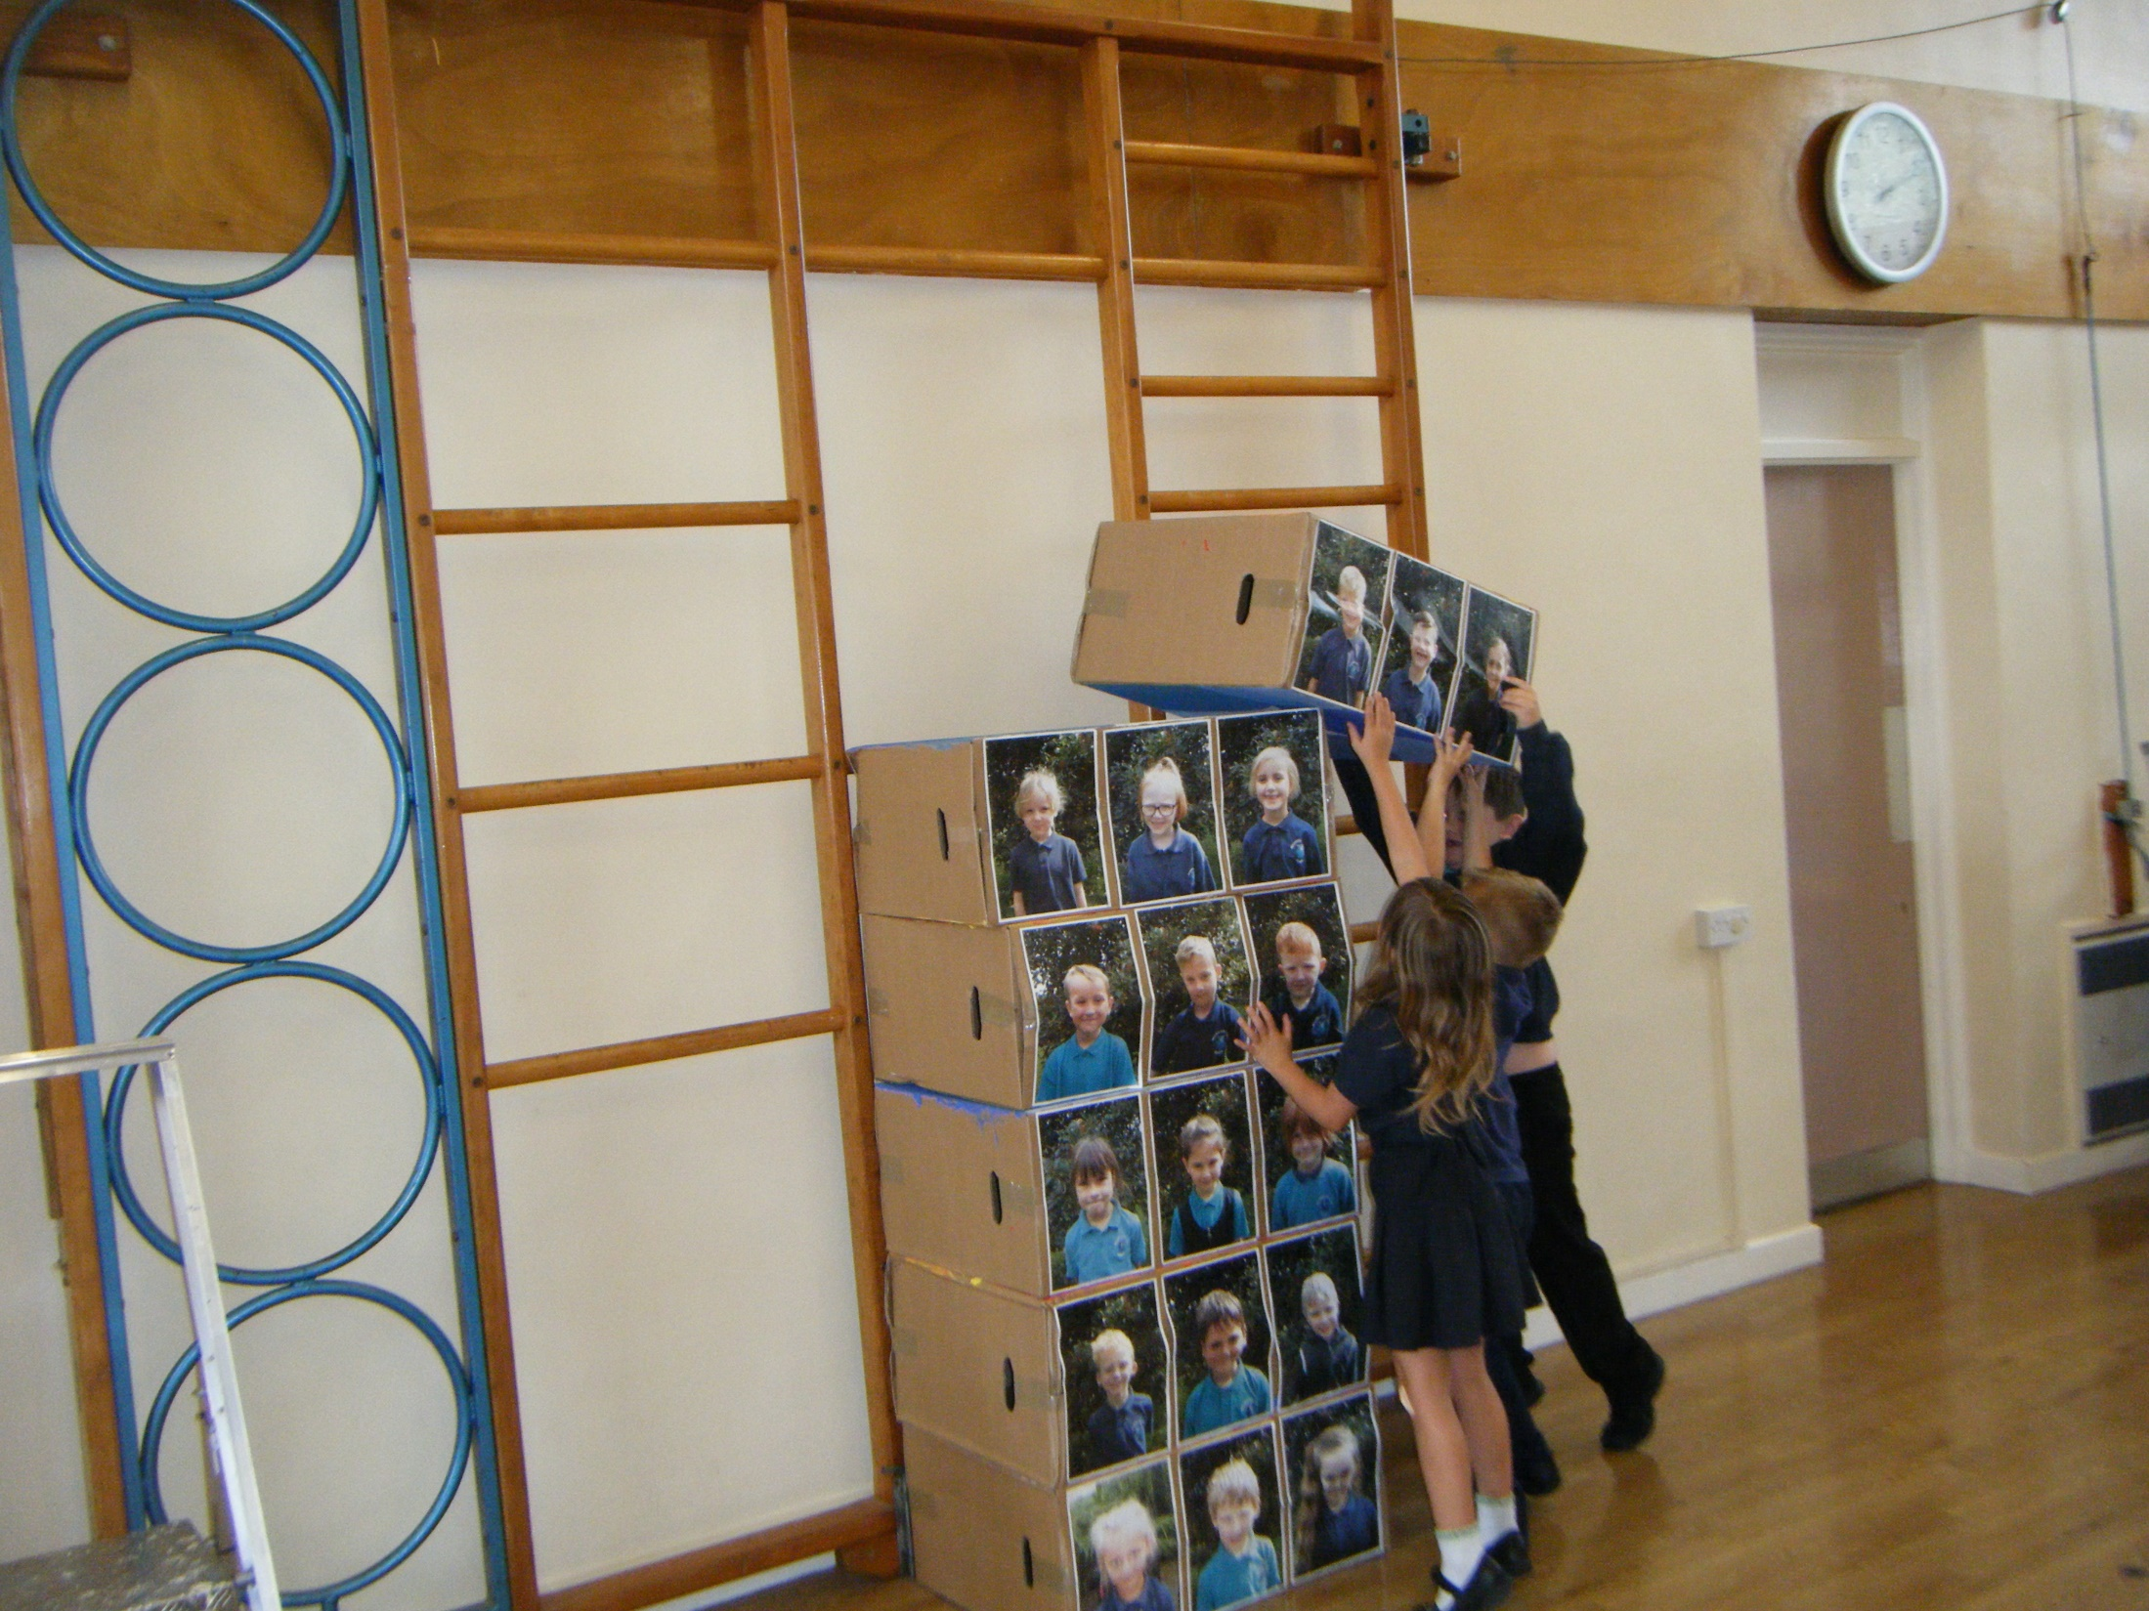
We built a big tower

Slide 11
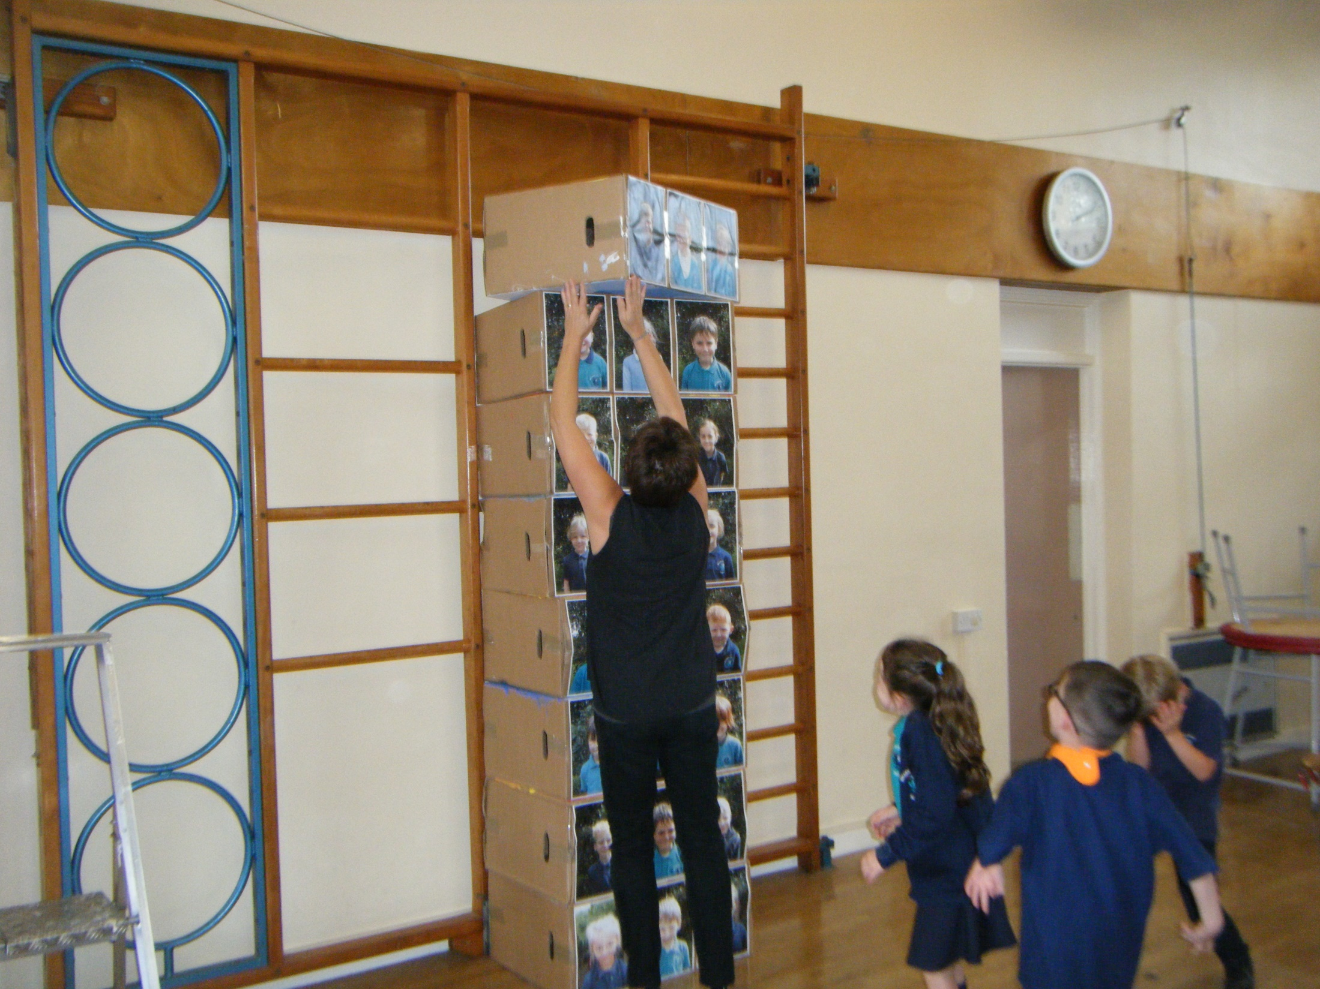
It got higher and higher

Slide 12
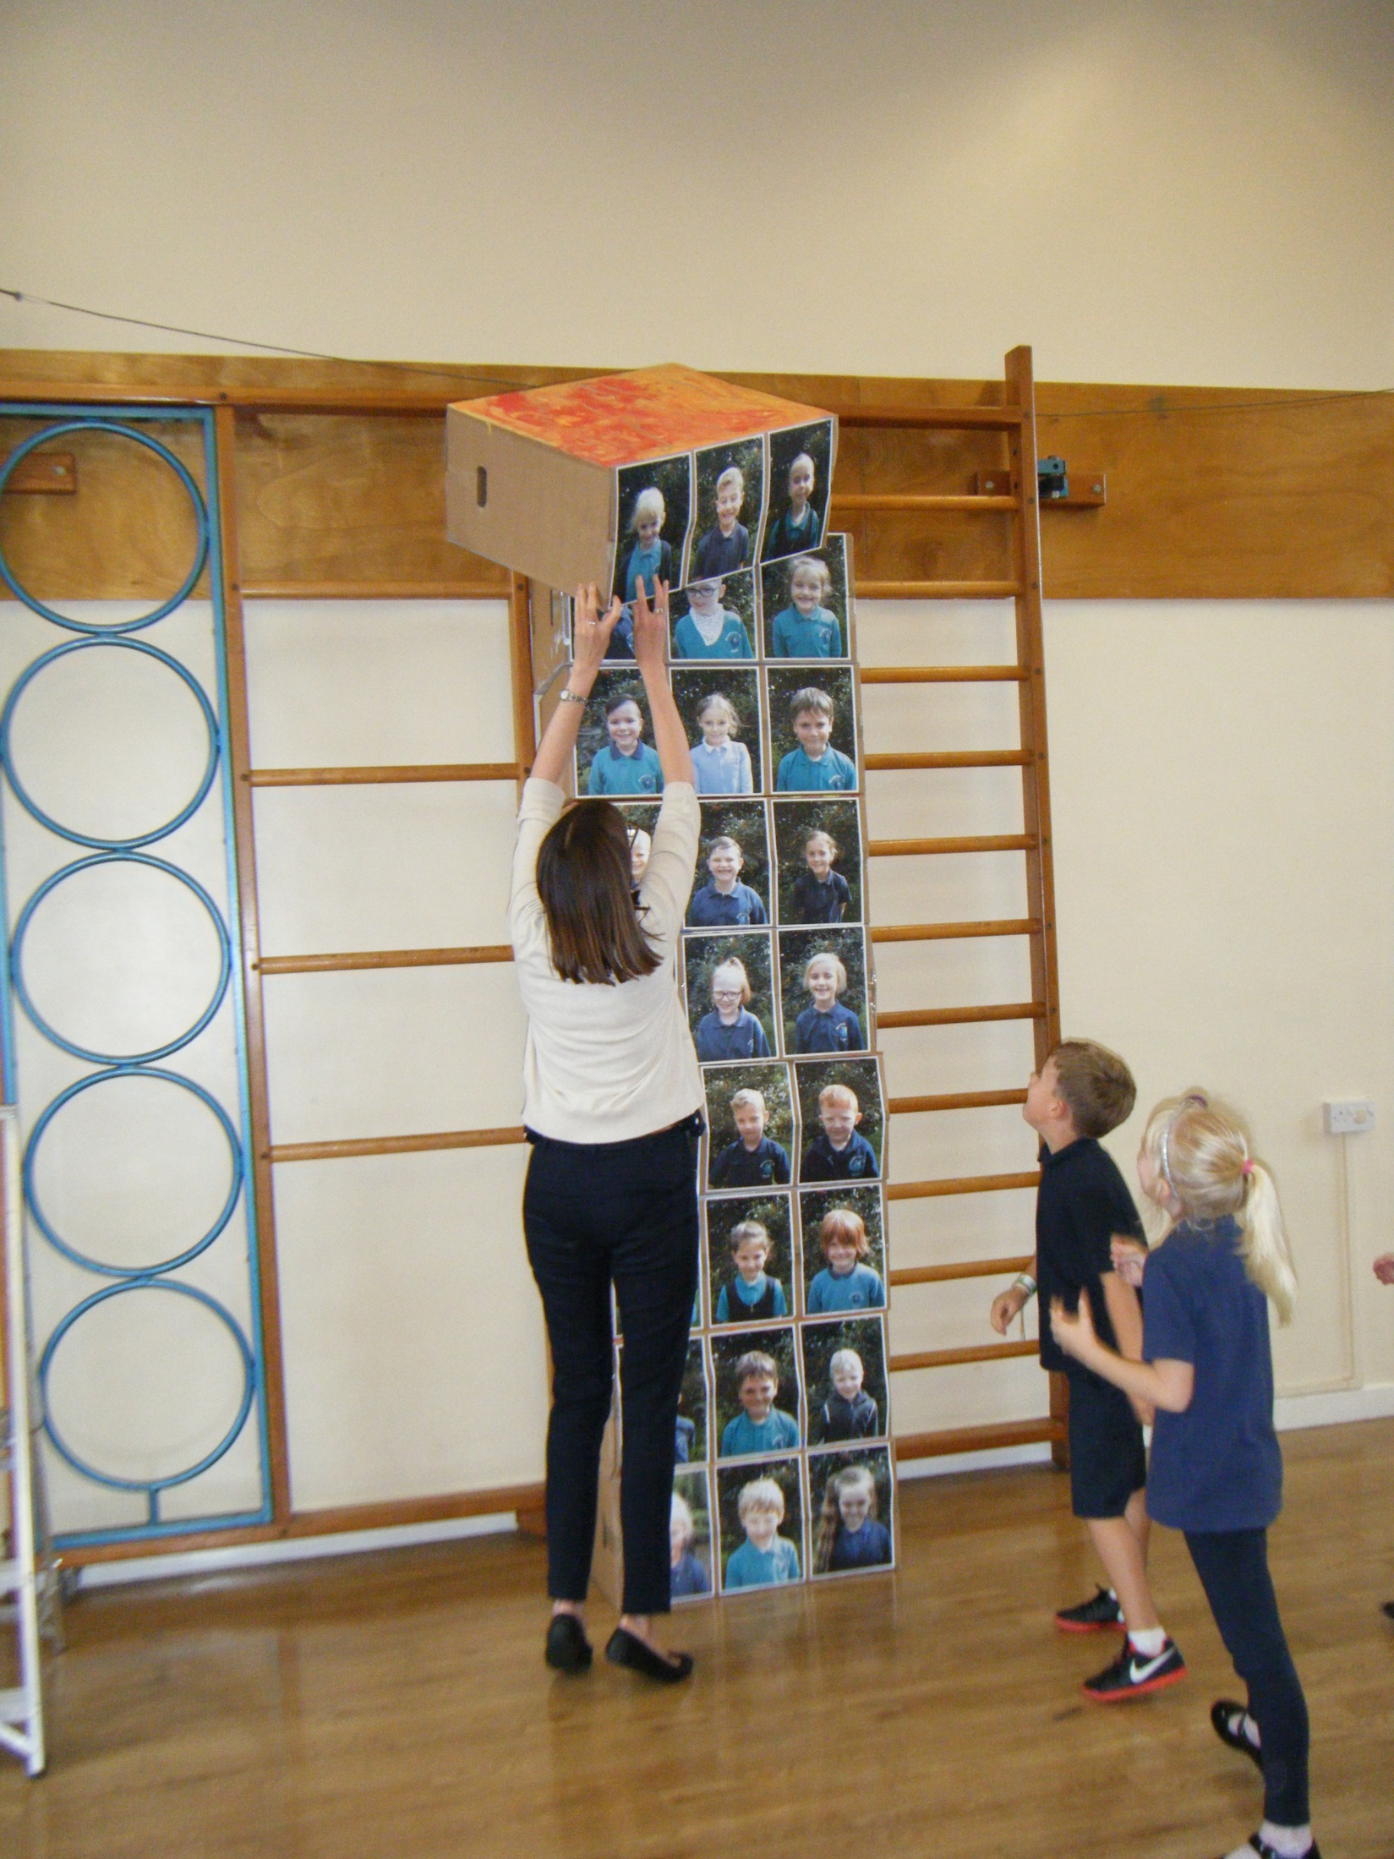
And even higher

Slide 13
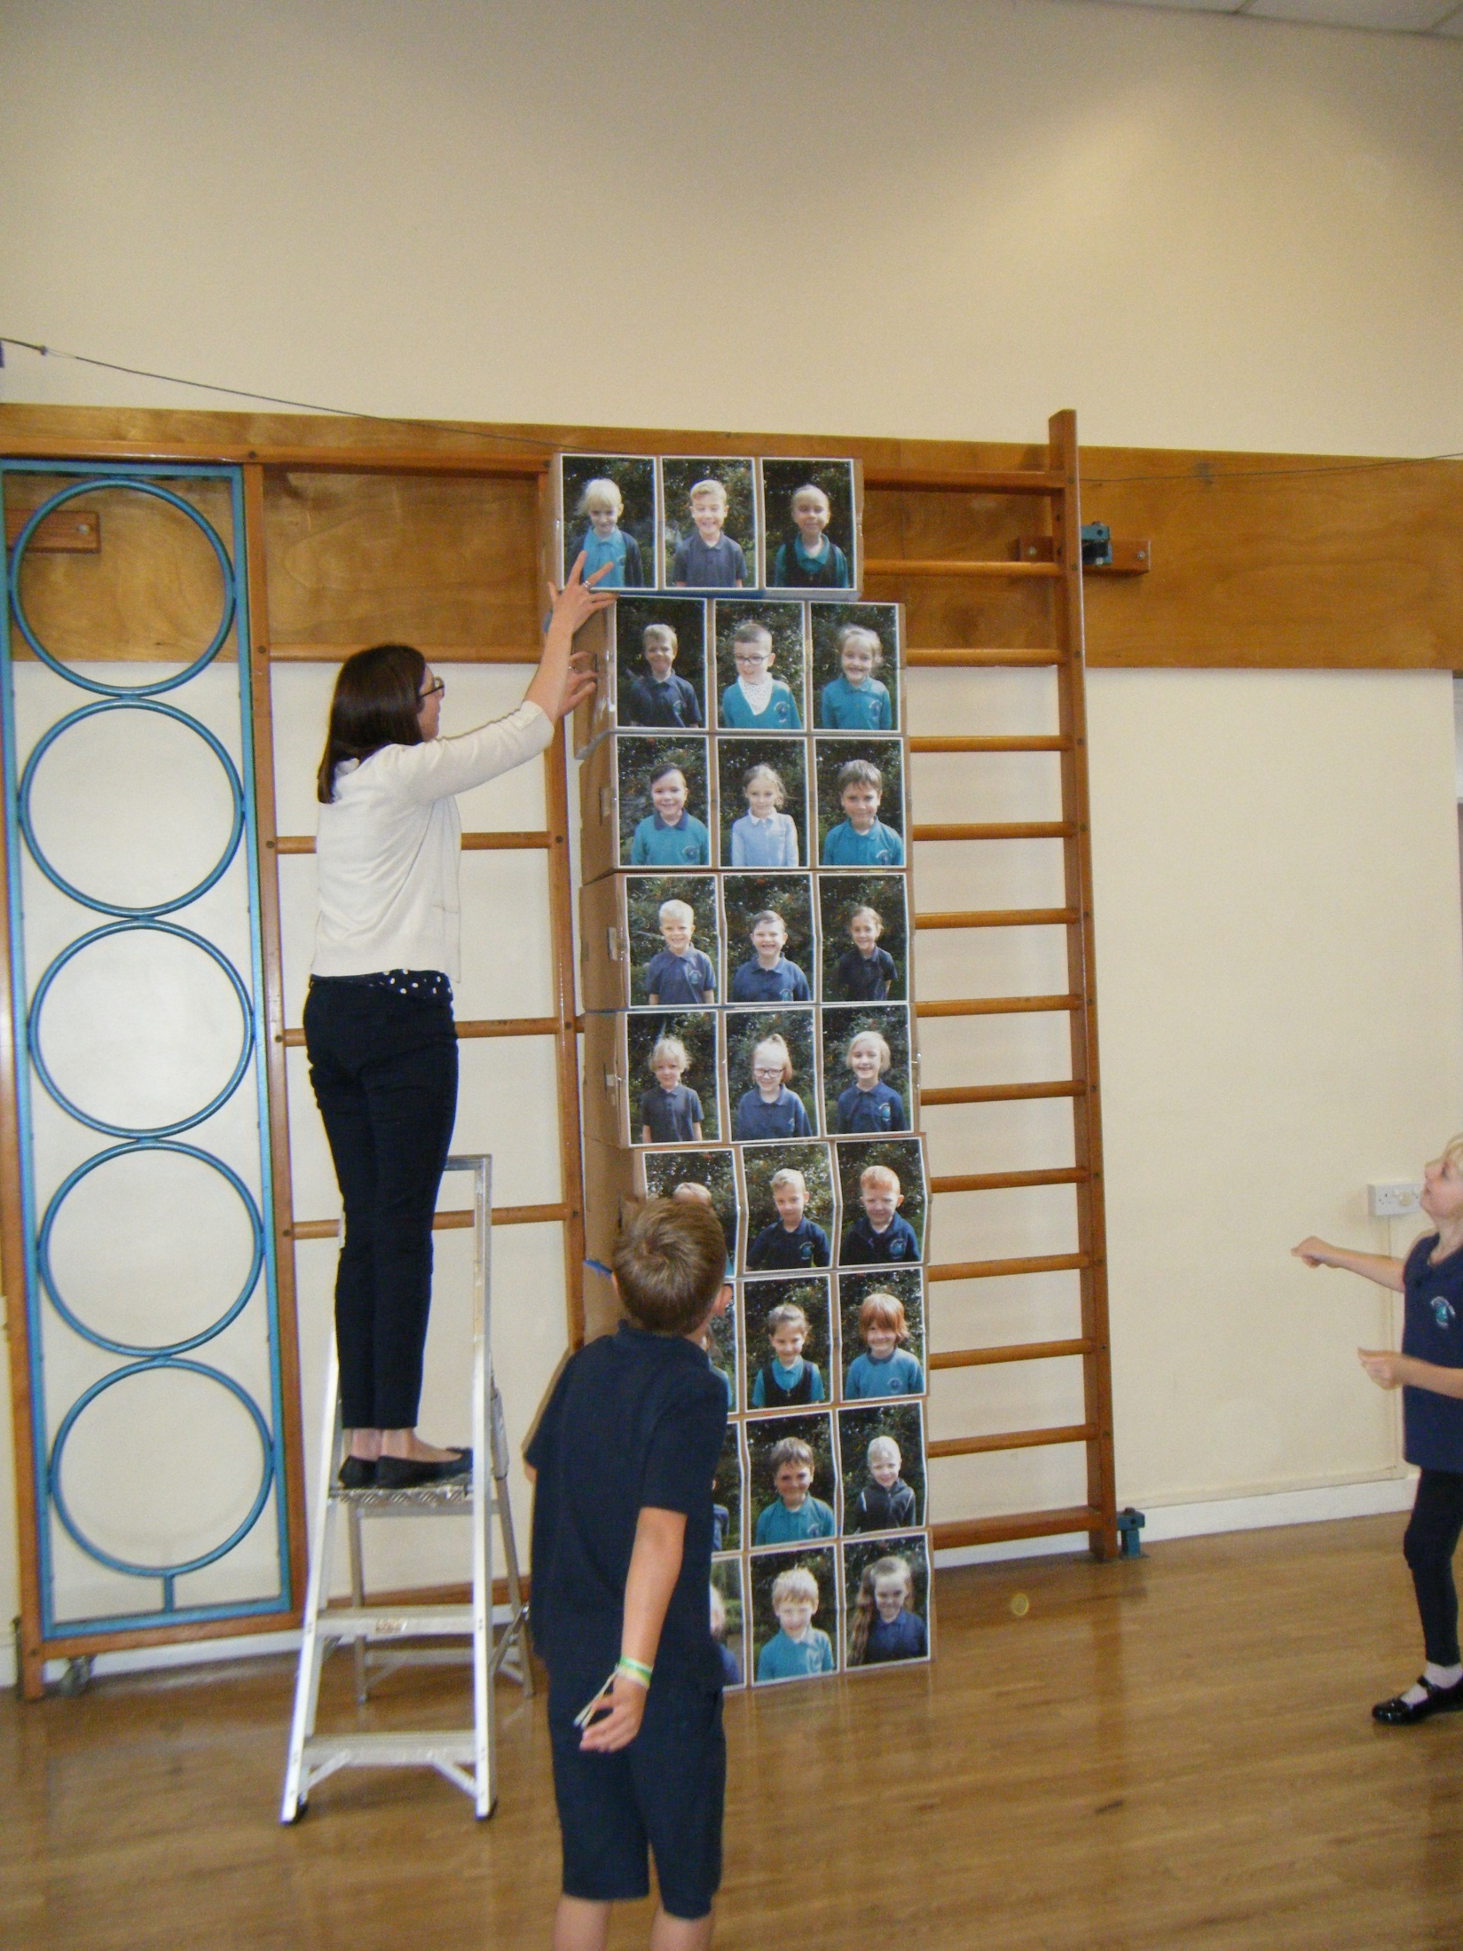
We needed a ladder

Slide 14
And more team work!

Slide 15
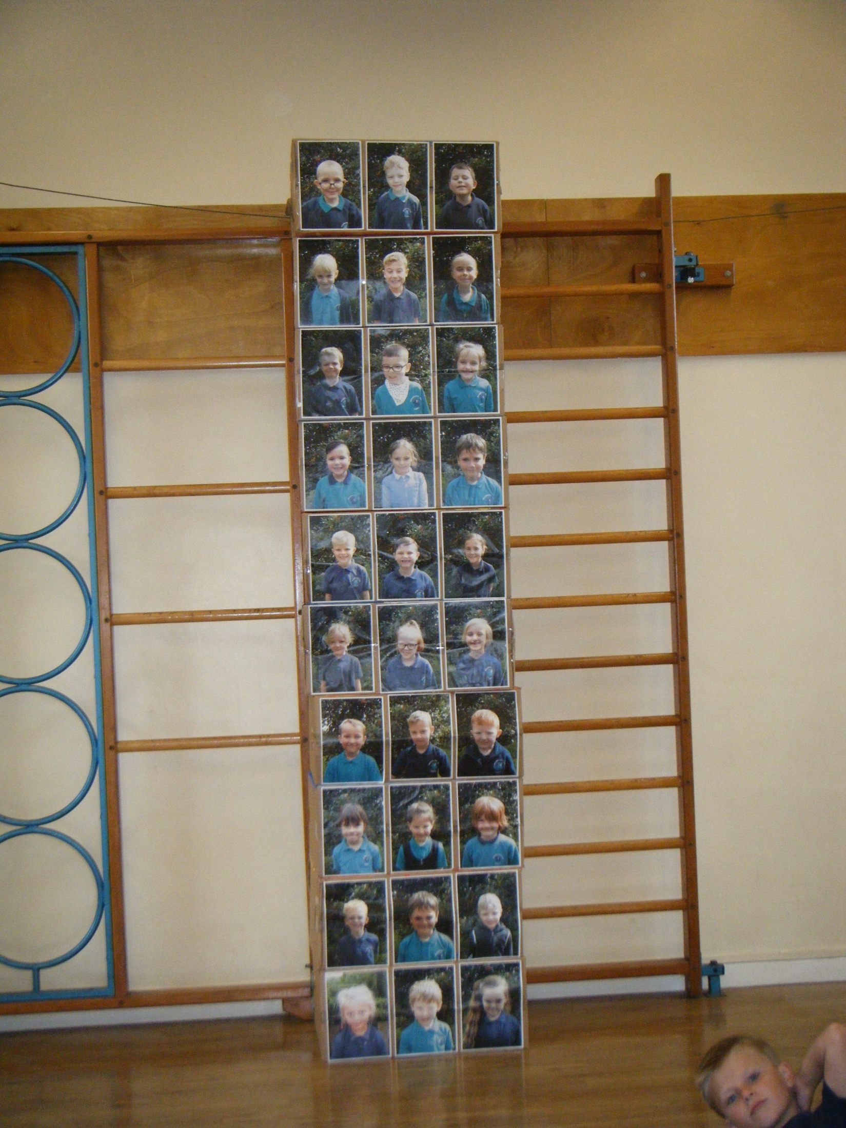
Hoooray! We did it!

Slide 16
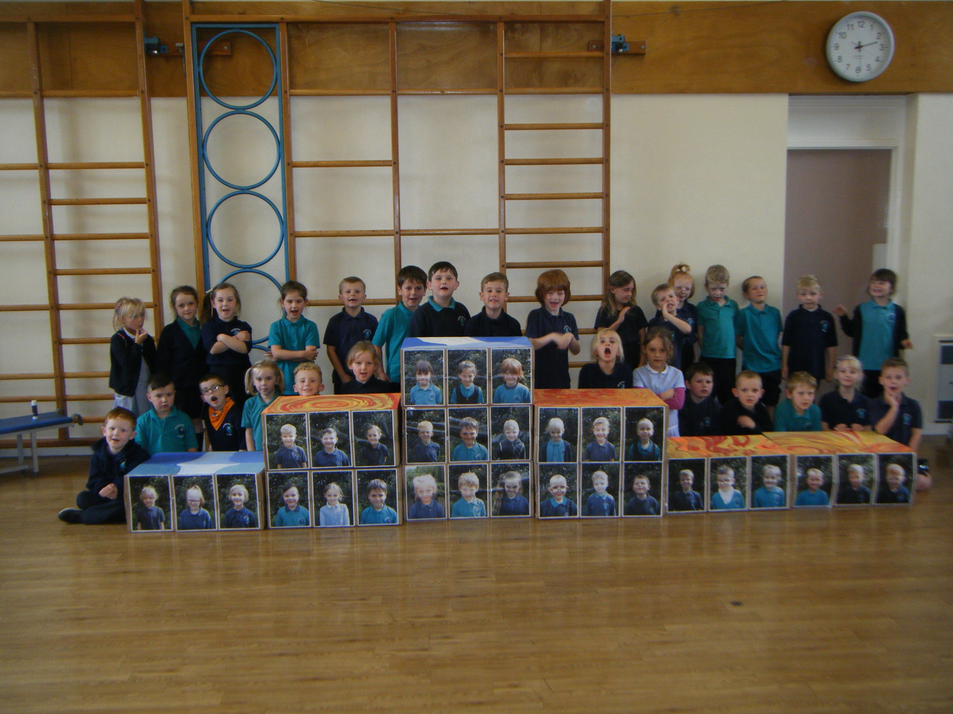

Slide 17
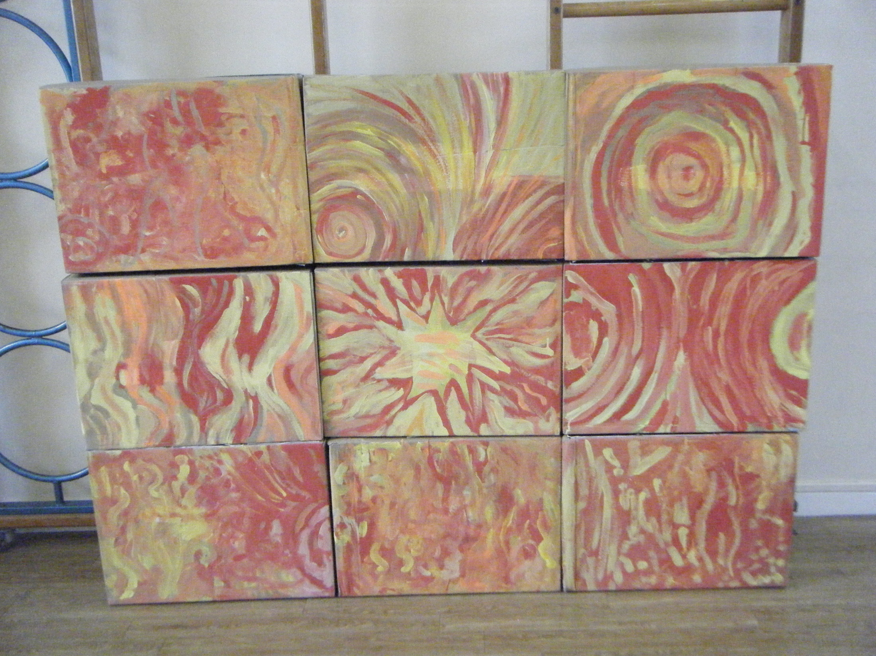
We used hot colours

Slide 18
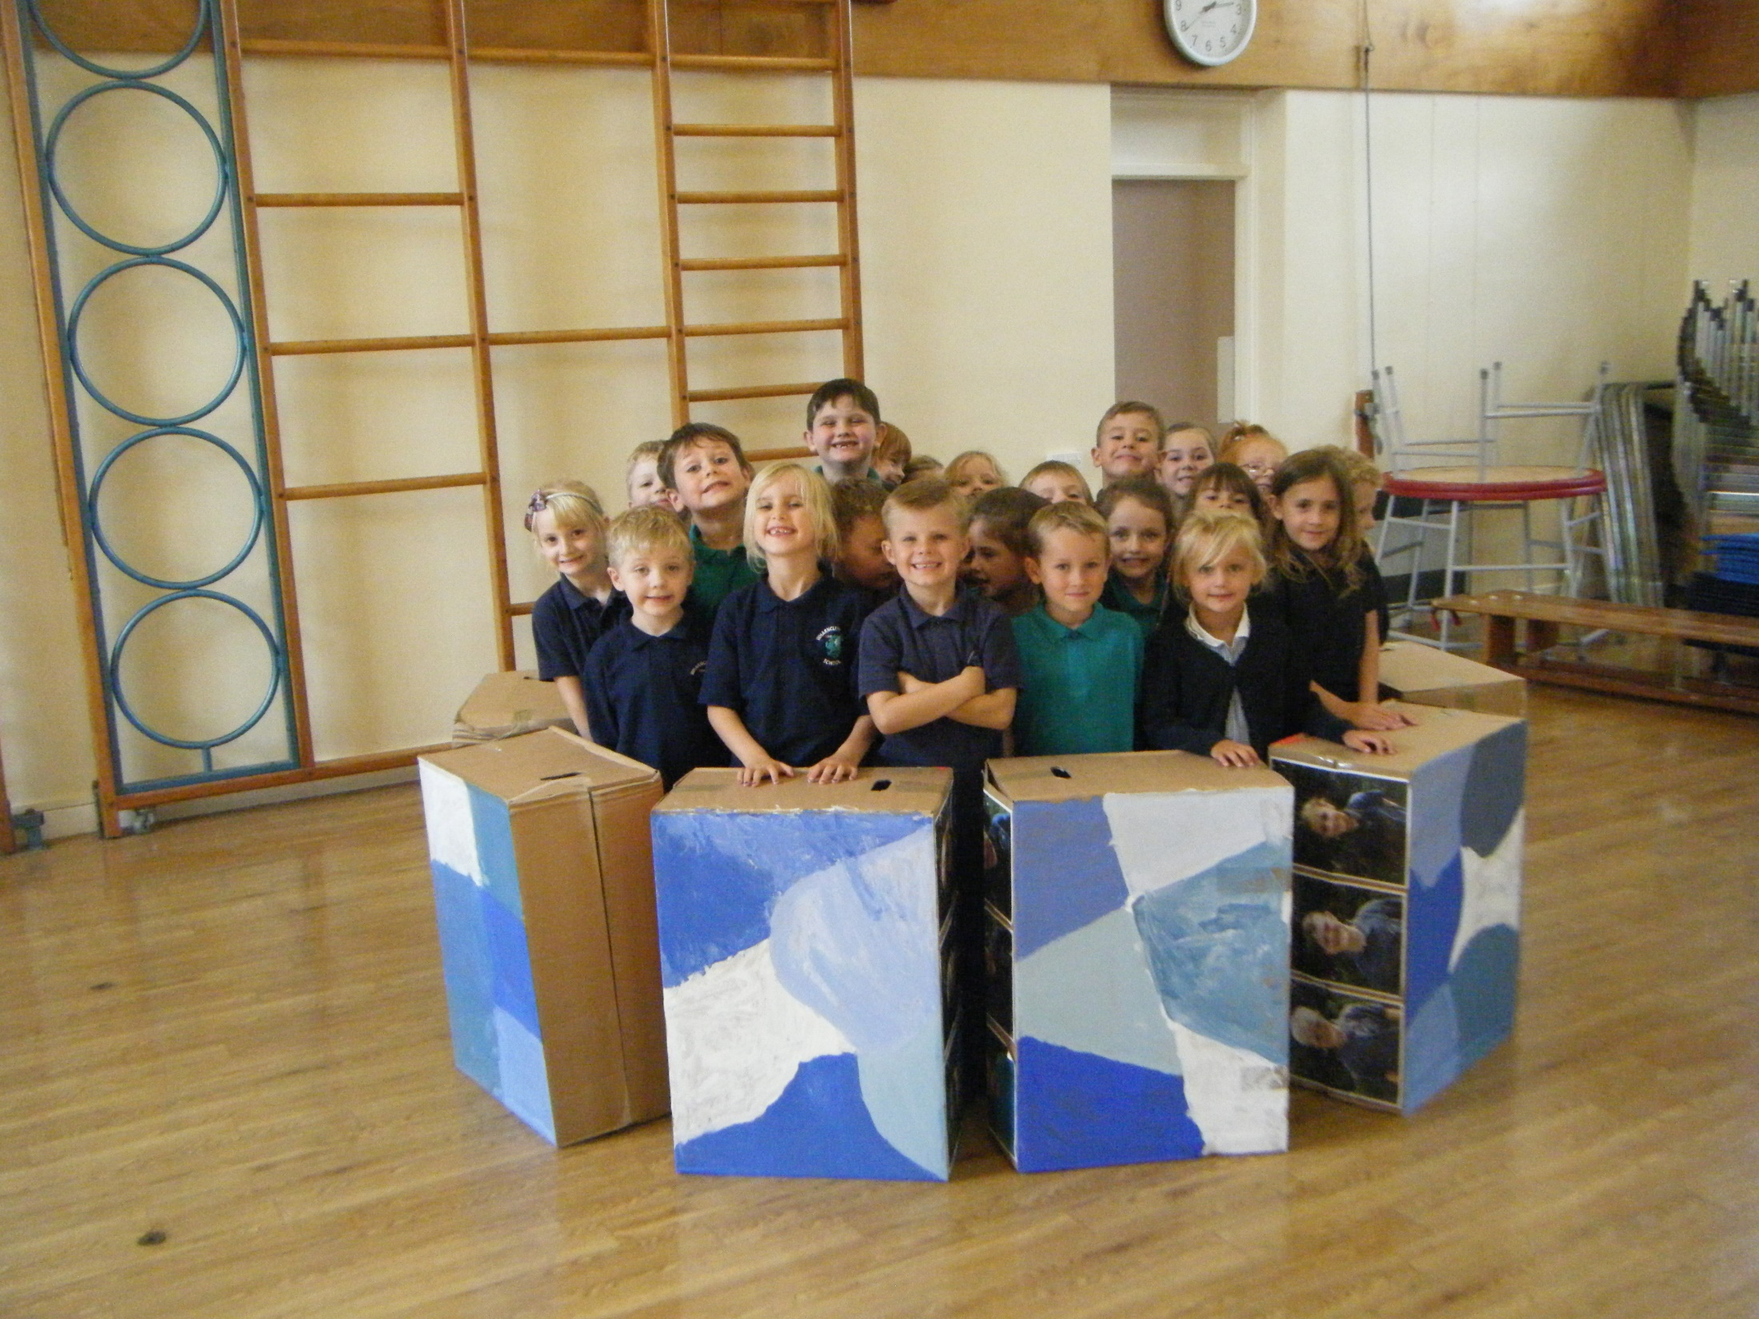
We made an igloo for us all to fit inside

Slide 19
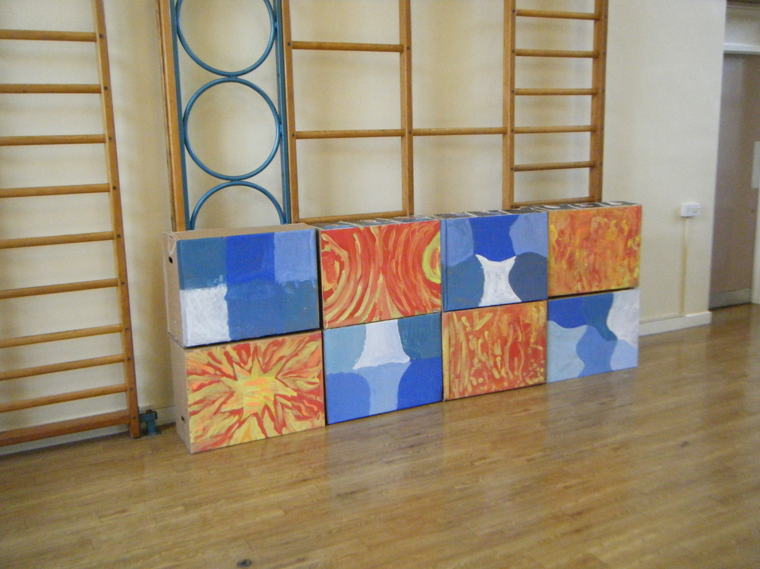
We tried lots of different ways

Slide 20
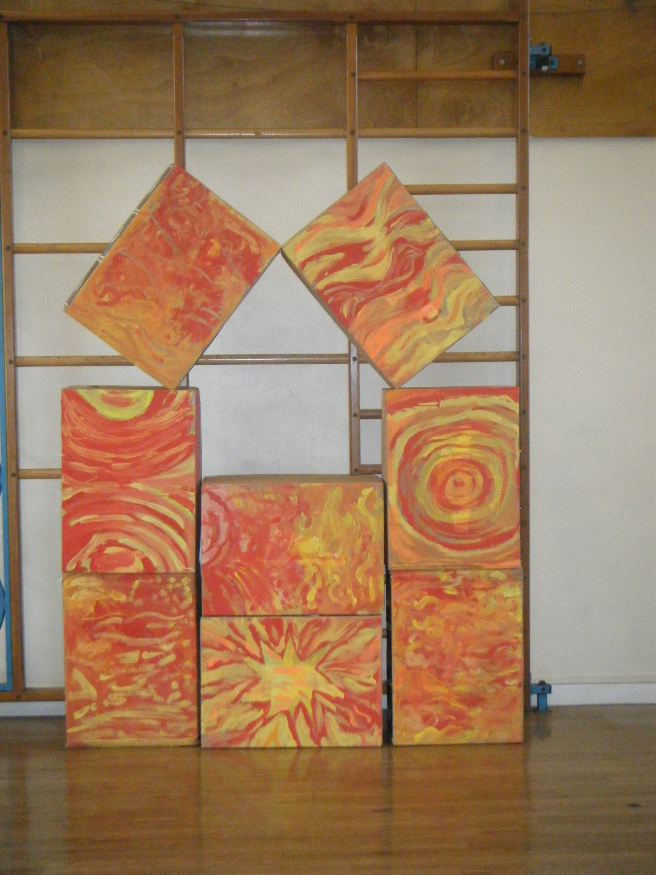

Slide 21
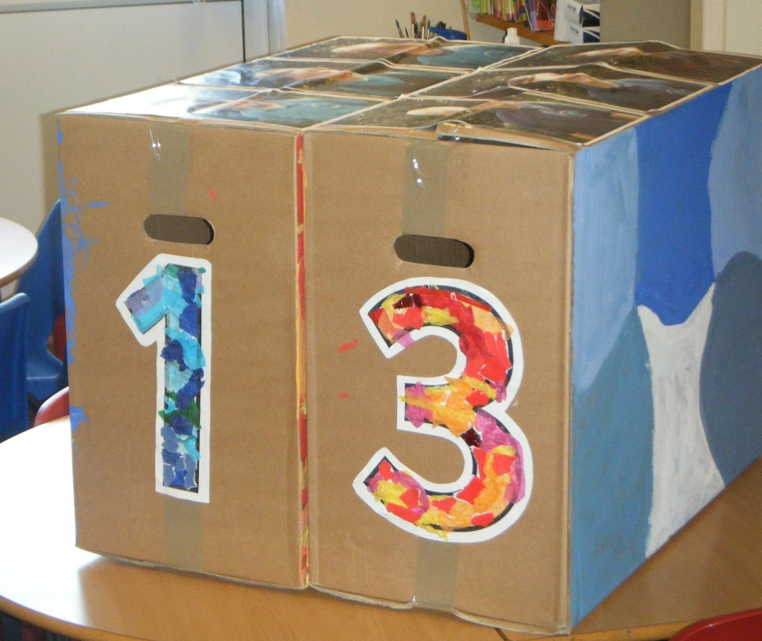
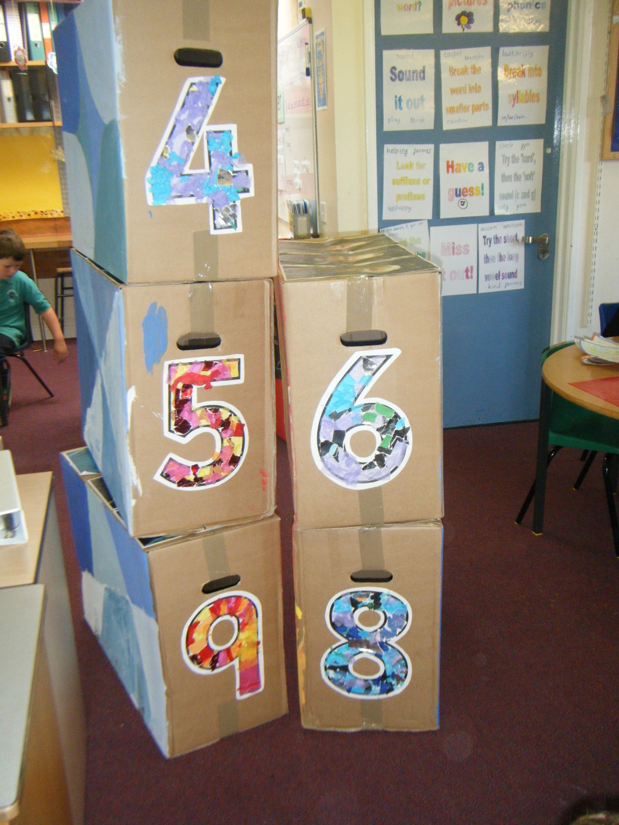
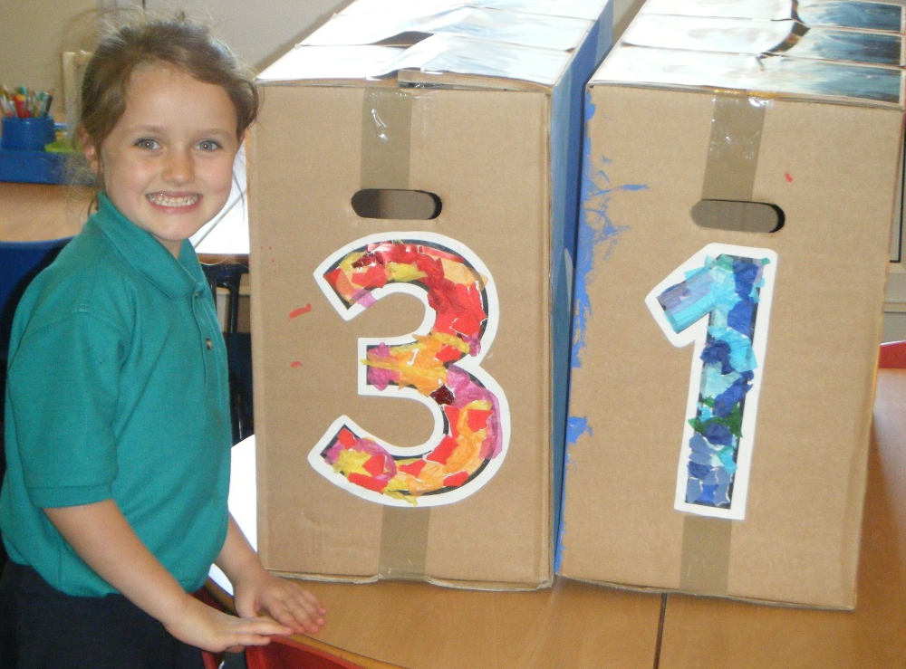

Slide 22
We have enjoyed learning a song about being friends

Slide 23
A couple of pleas!
It would be wonderful if your child had a book bag (these fit perfectly in their drawers).
Please keep the reading journal and reading book in the book bag then we can add to it at school as well as you using it at home.
Please could children be discouraged from bringing bags to school.
Water bottles should come home each night so that they can be washed out and refilled at home.

Slide 24
Please name all items of clothing (PE, Forest Schools, Wellies etc)
Unfortunately, we do not have the space to keep bags of clothes/wellies in the cloakroom. Please check the clothing in the classroom before you go!

Slide 25
Home learning
Spellings will be stuck in reading journals on a Friday (there is a full week to practise these). We will have a ‘test’ on Fridays.
Children will have a spelling booklet that they keep at school to practise as their morning job.
Weekly home learning (SPaG mats and mental maths activity) will come home each Monday. Children will be given a weekly raffle ticket when they bring it back. We will do a ‘Maths check’ on Monday morning linked to the previous mental maths task.
The topic home learning tasks are more open ended and will be celebrated whenever they are brought back to school…the more creative the better!

Slide 26
Thank you for coming!

